Slide 1
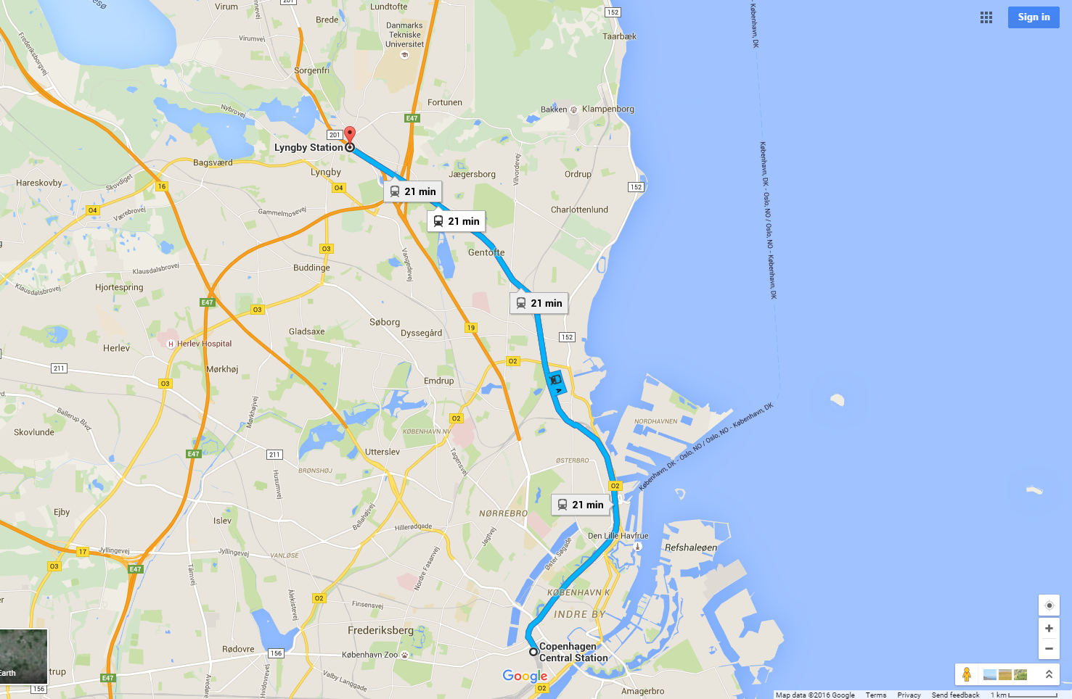
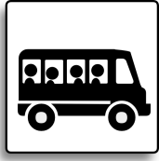
DTU
4M/IWMF BUS SHUTTLE
Lyngby St.
Jægersborg St.
Gentofte St.
Østerport St.
Nørreport St.
Copenhagen Central St.
Vesterport St.
Dybbølsbro St.

Slide 2
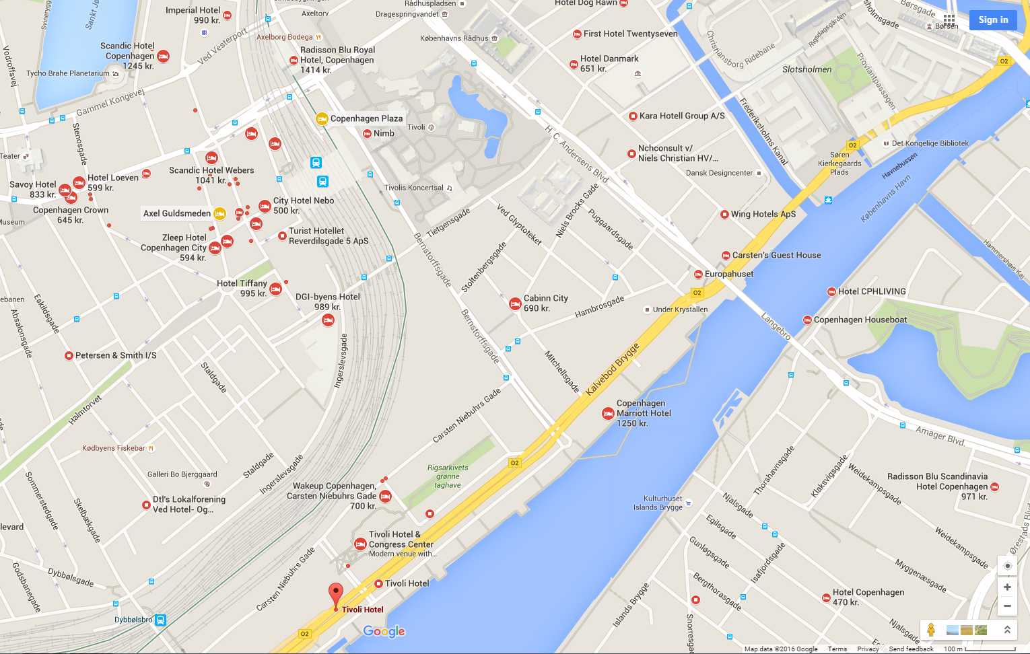
2
Hotels near
1: Copenhagen central station
2: Vesterport station
3: Dybbølsbro station
Scandic Hotel Copenhagen
Radisson Blu Royal Hotel
DGI-byens Hotel
Wakeup Copenhagen
Tivoli Hotel
1
3

Slide 3
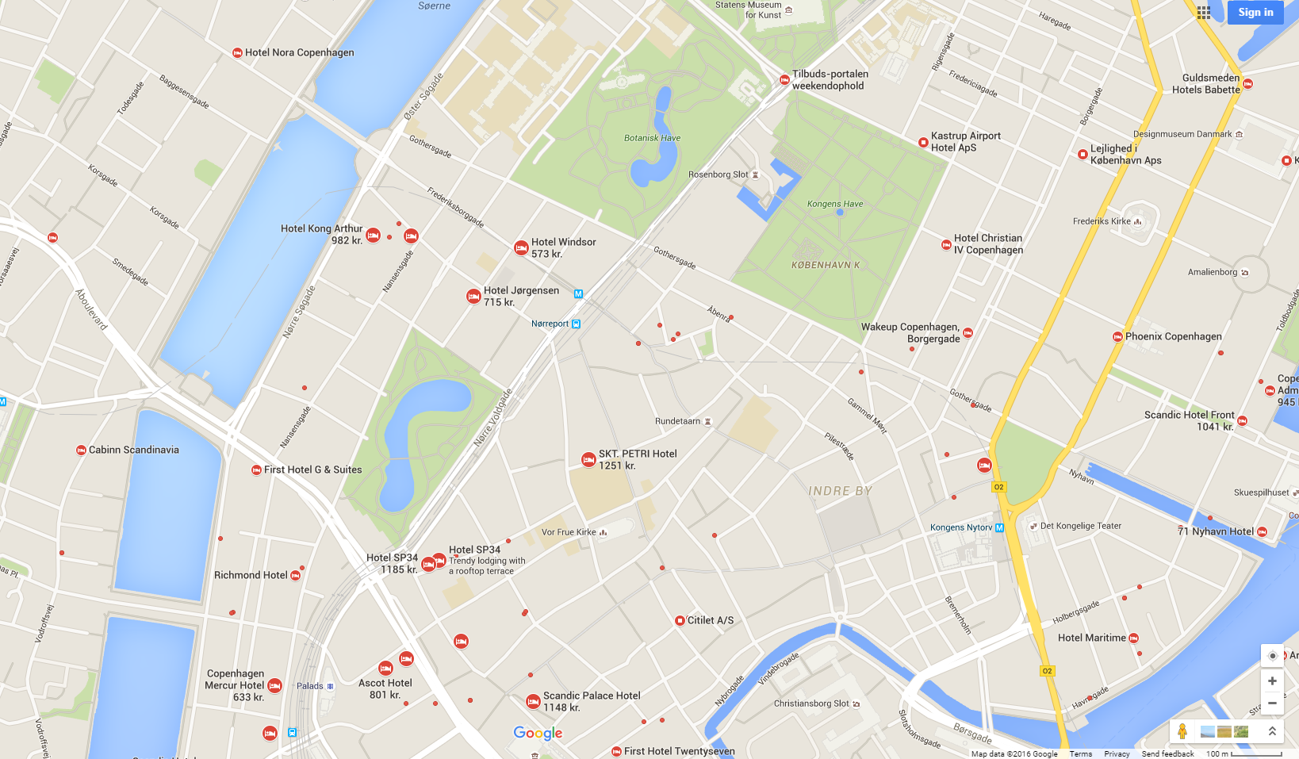
Hotels near
1: Vesterport station
2: Nørreport station
Hotel Kong Arhur
Richmond Hotel
Hotel SP34
Copenhagen Mercur hotel
2
1

Slide 4
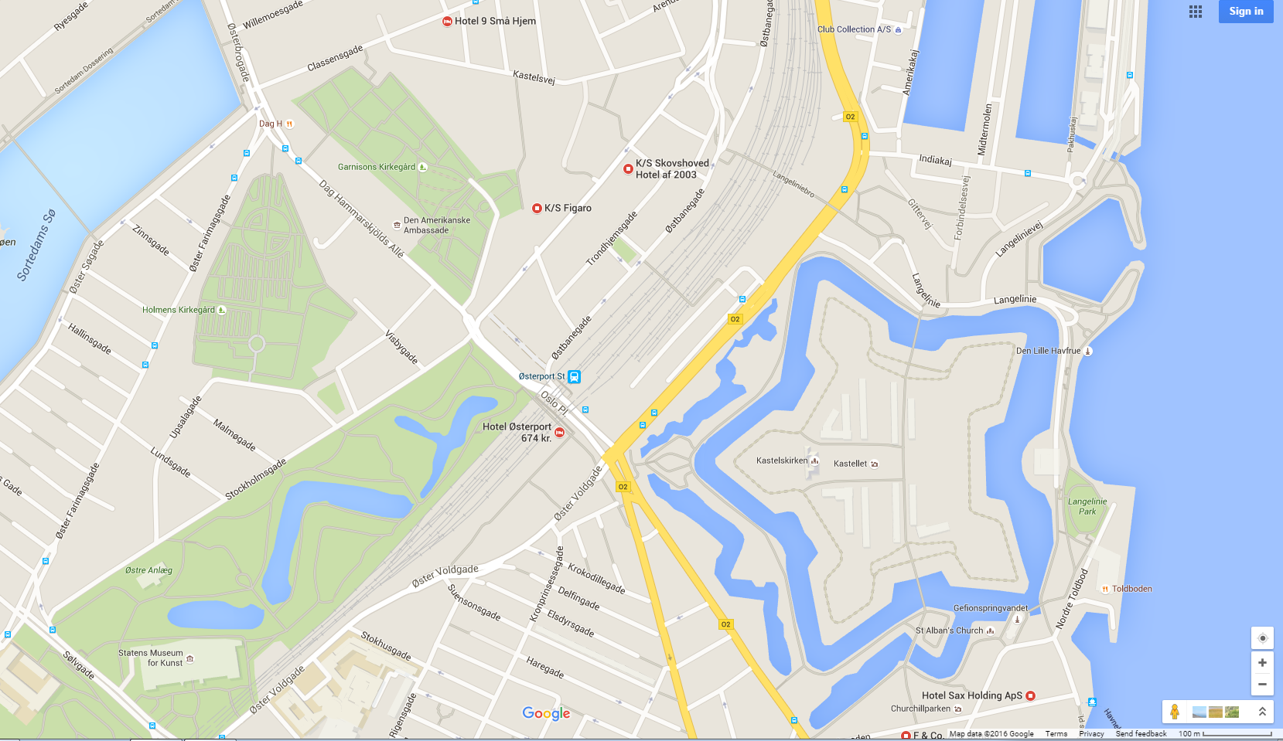
Hotels near Østerport station
Hotel Østerport

Slide 5
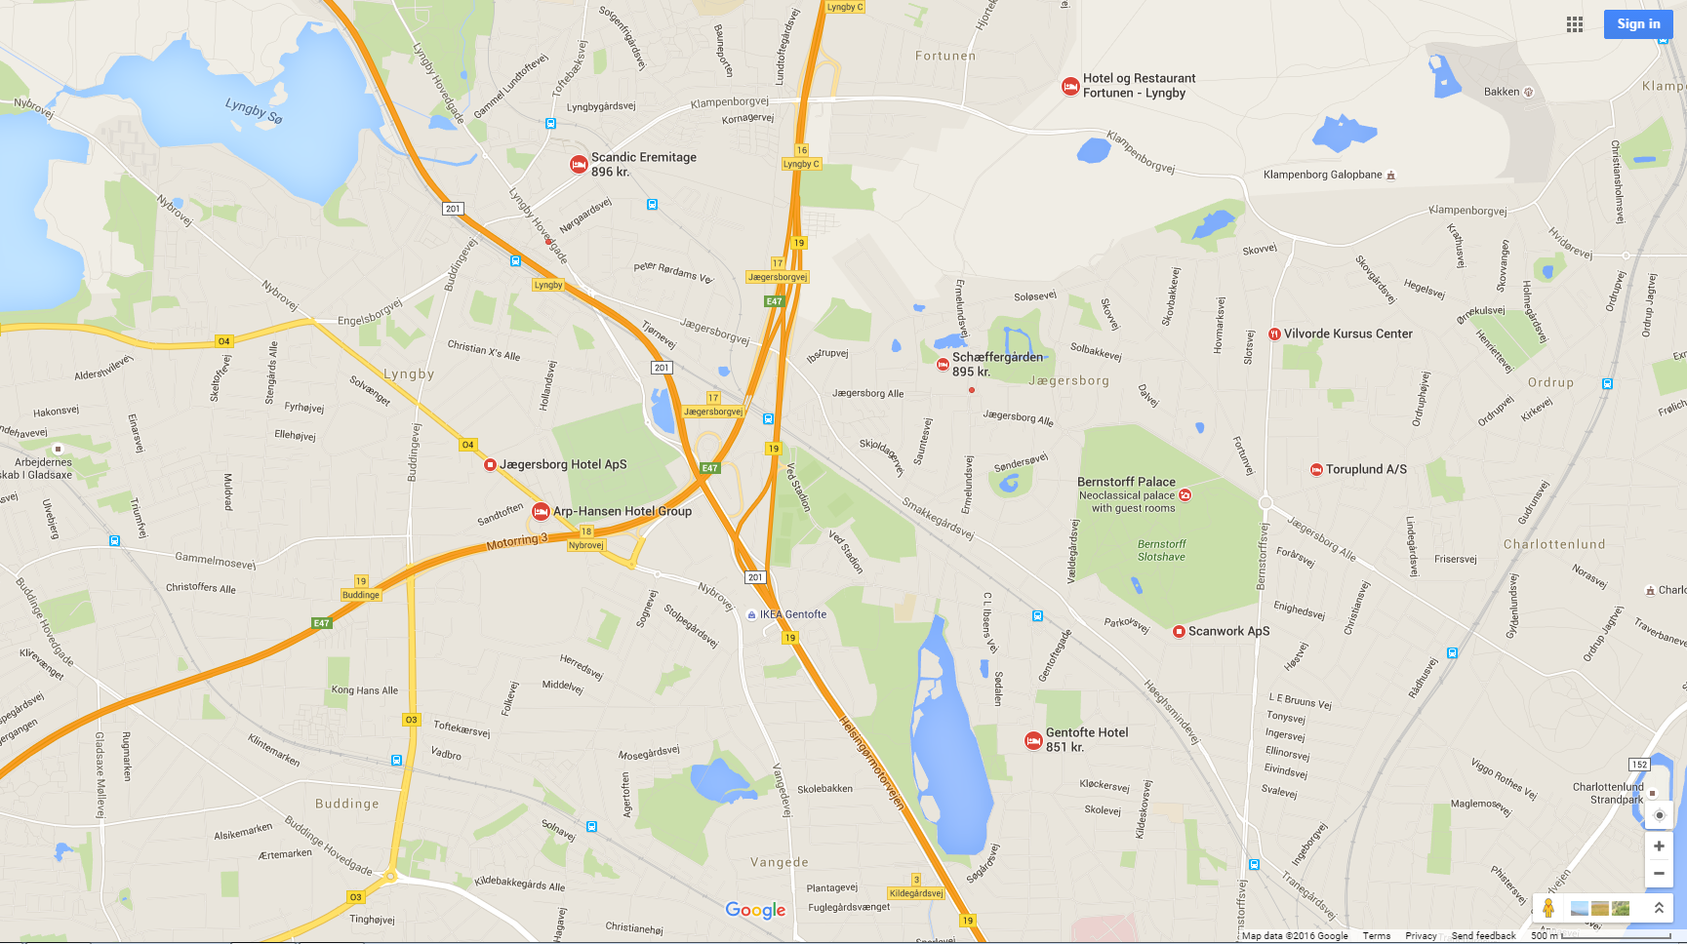
Hotels near:
1: Lyngby station
2: Jægersborg station
3: Gentofte station
Scandic Eremitage
Schæffer-gården
Gentofte Hotel
1
2
3

